Slide 1
Northland Bowling & Associated Businesses
By Team Freft (Tristan, Mark, Mark, and Brenden)
Notes:
brenden

Slide 2
Interface
We chose to do a desktop or laptop-based prototype instead of a mobile device prototype
Our prototype is a website for Northland Bowling, including sections for Northland Motel and Arena Bar and Grill
Notes:
brenden

Slide 3
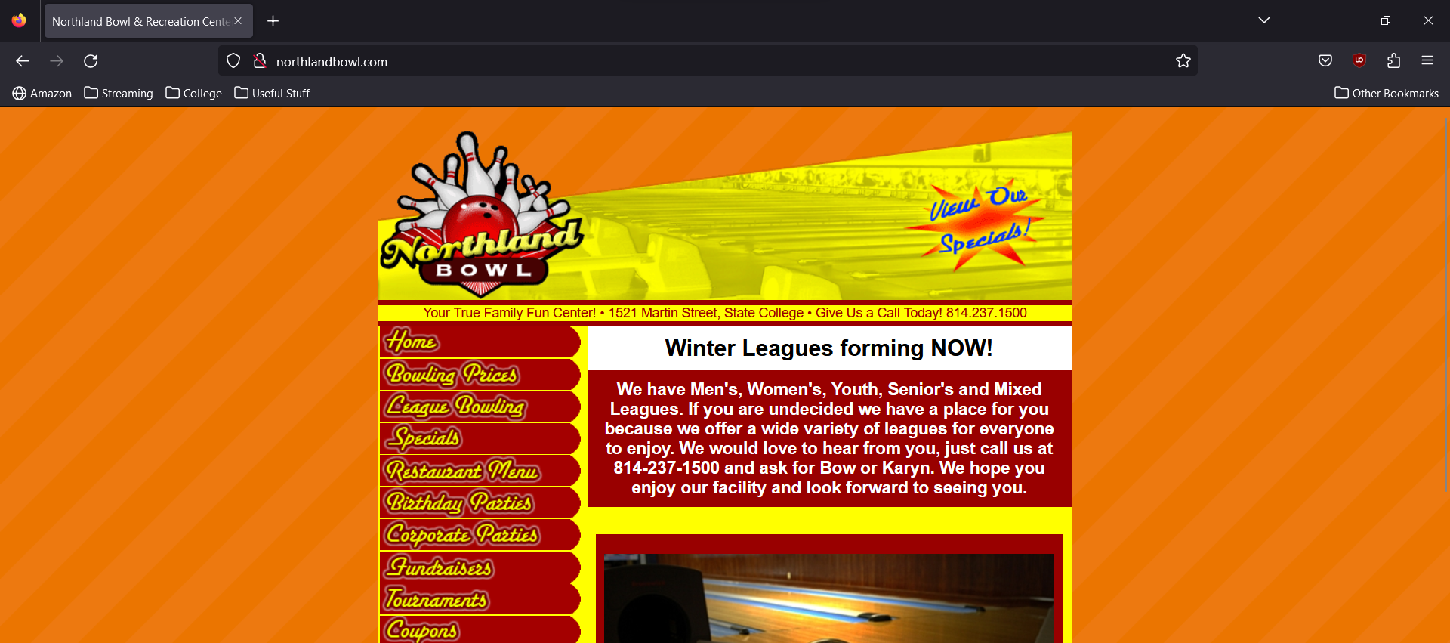
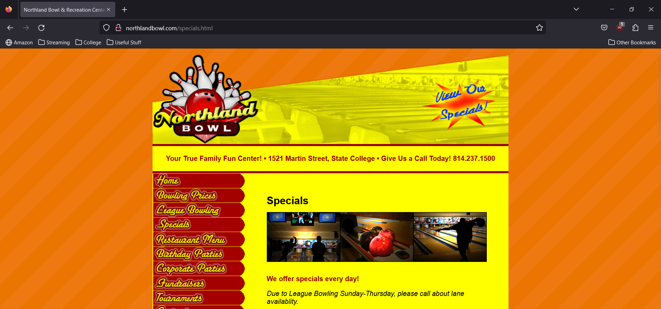
Heuristics Issue with Current Design #1
Consistency and Standards: The size of the content changes between pages
Notes:
Mark w

Slide 4
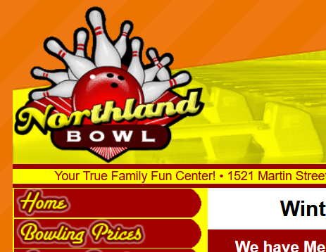
Heuristic Issue with Current Design #2
Flexibility and Efficiency of use: The logo in the top right corner did not allow the user to navigate to the home page
Notes:
Mark w

Slide 5
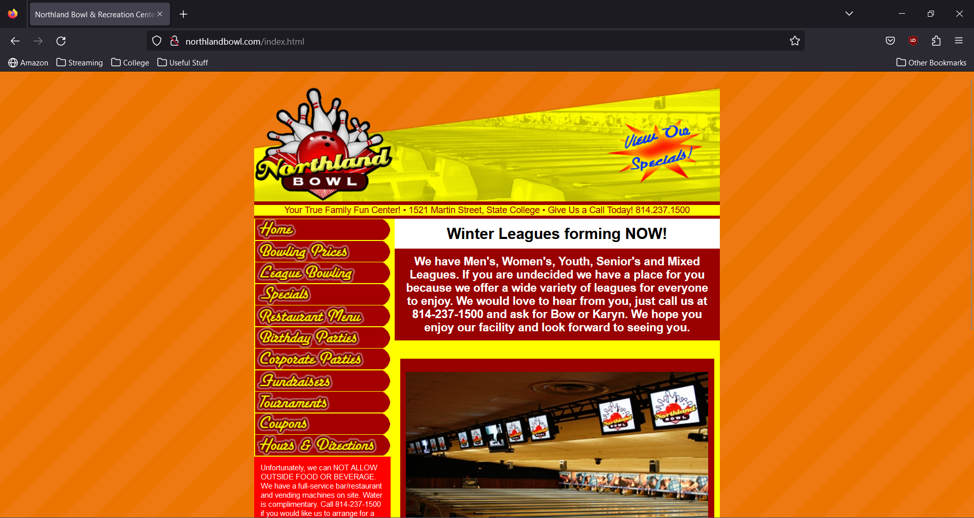
Design Guideline Issues
Aesthetic and minimalist design (Nielsen): While the design could be considered minimalistic, the aesthetic is harsh:
Notes:
Mark w

Slide 6

Stakeholders
Businesses- Northland Bowling, Northland Motel, Arena Bar and Grill
Users- Bowlers, diners/drinkers, motel patrons
Notes:
Mark R

Slide 7
What you learned from creating user profiles, personas, and scenarios
We were able to understand user goals and motivations and how they could perceive certain information.
Helped identify possible pain points for users and potential design solutions and what add and what to improve upon
Creating these also helped prioritize certain design features and feedback emphasizing what the user really needs
Also helped avoid biases and allowed us to test certain assumptions we made about Northland Bowling
Notes:
Mark R

Slide 8
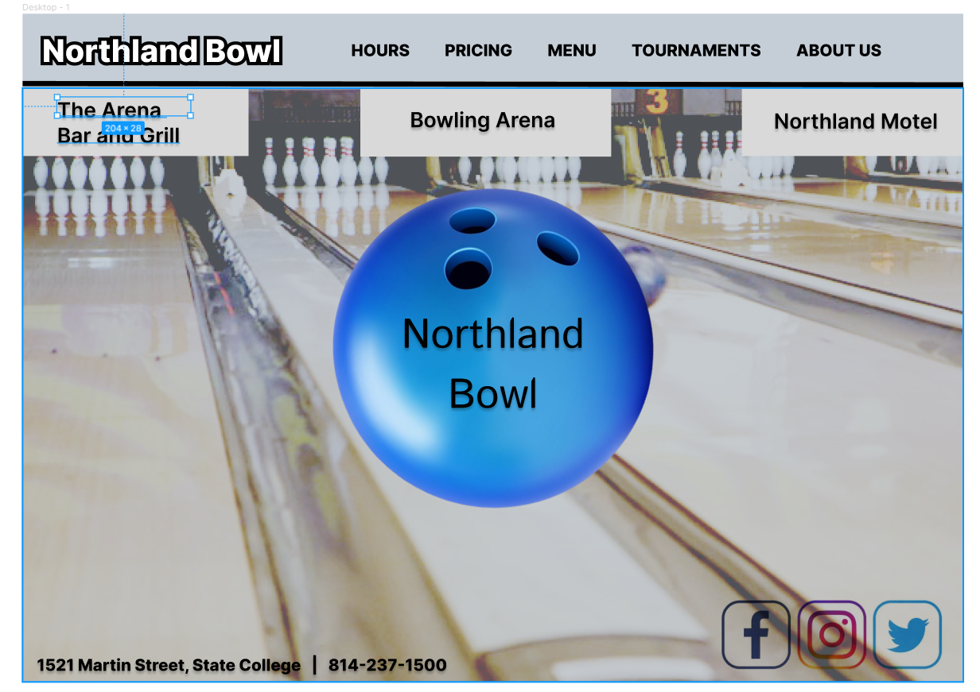
Our low-fidelity prototype
Our team's vision for the redesign was to develop a cleaner and easier to navigate design with a different color scheme from the original. Our team also wanted to include the use of clickable buttons and accessible links.
Our low-fidelity prototype was originally created by drawing with pen and paper to individually brainstorm a design for our website. After we were finished with our drawings, we took the ideas that we liked from each of them and created an online visual representation prototype on Figma.
Notes:
Mark R

Slide 9
Overview of usability testing
What were the goals of your usability testing?
Our goal was to outline potential demographics that represented the customers of Northland and how they would interact with our design.
What tasks did your users perform?
We had them test scheduling birthday parties, getting directions and checking motel room availability.
What were your major findings and recommendations?
We realized that it took too many clicks to get proper directions and the path was confusing based on feedback
There wasn't any actual working link for scheduling a birthday party.
The scrolling feature wasn't working properly on motel availability and the link was placed in a way that it confused the user.
How did you use the results of the usability testing to improve your design?
We created specific link for directions that shortened click path.
Fixed scrolling on all pages.
Created direct links for scheduling and directions.
Notes:
Brenden

Slide 10
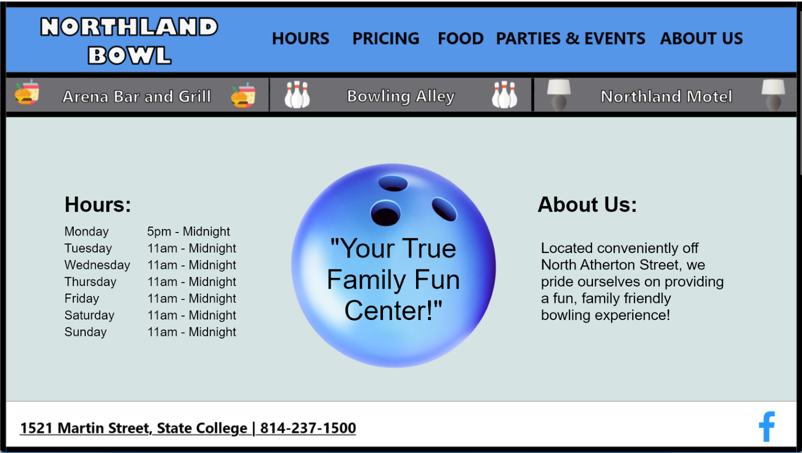
Final design
Designed in Adobe XD
Link: https://xd.adobe.com/view/09b50bba-0ff5-405e-9b9e-ad2a3d191540-5ce6/
Notes:
Tristan/ all

Slide 11
Final Design Heuristics, Principles, and Guidelines
Heuristics:
Match between system and real world- Website color matches Northland Bowling's exterior color (light blue)
Flexibility of use- Many different ways to navigate to home page
Aesthetic and minimalist design- Simple pages, pleasing colors
Principles:
Consistency- Pages all have common fonts, colors, nav bar
Hierarchy- 3 tabs for the three businesses are prominent
Guidelines:
Accessibility- Our prototype could be made in html, which is easy for screen-readers to process
Notes:
Tristan

Slide 12
Final Design vs northlandbowl.com
Current site: Glaring color choice
Our design: Easy-on-the-eyes light blue
Current site: Inconsistent size of pages
Our design: Consistently sized page elements
Current site: Northland Bowl Logo isn't a link to home
Our site: Logo is a link to home
Notes:
Tristan

Slide 13
Challenges Faced
How do we use Adobe XD?- Learn by doing. Many mistakes made along the way.
How do we apply changes made to each page?- Create a component in XD, then changes made to the main component are reflected on all pages
How should we structure the 3 parts of the site?- We looked at different designs in our low fidelity prototypes and chose the three-tab design
How do we make the design 'feel' good?- After initial high-fidelity prototype, we made the nav bar smaller and made all elements more consistent
How do we incorporate feedback from usability testing?- Condense feedback as a team and choose important and do-able items
Notes:
Tristan

